Slide 1
Making online security risks tangible
Professor Sadie Creese
Professor Koen Lamberts
Nick Papanikolaou
Research Fellow International Digital Laboratory University of Warwick
N.Papanikolaou@warwick.ac.uk
http://digital.warwick.ac.uk/E-Security/
TexPoint fonts used in EMF.
Read the TexPoint manual before you delete this box.: AAΑΑΑΑΑΑΑΑ

Slide 2
introduction
This work is the product of a collaboration between
The International Digital Laboratory, University of Warwick
The Department of Psychology, University of Warwick
Computer scientists are keen to take advantage of what is known about human perception of risks
...so as to reduce online fraud and damage to computer users’ data;
...so as to enforce security policies in a user-friendly way.
Cognitive science has much to offer in this regard, since much is known about how information can be communicated effectively to users, taking into account the structure of the brain
The central issue is how risk can be communicated effectively to users of computer systems

Slide 3
Online threats - risks
As the Internet pervades our lives we become susceptible to online security threats
There are threats involving direct user-to-user interactions
Social engineering
Email scams
... And threats to a user’s data
Trojan Horses
Viruses
P2P File Sharing
Malware

Slide 4
Online threats - risks
Online security is of concern to everyone
In its infancy the Internet was the province of a handful of specialists, who were usually well versed in IT security
... so potential risks were understood reasonably well
The vast majority of Internet users today does not have even a basic understanding of online threats
Dangers / Potential Costs
Loss of data
Theft of data
Unauthorised access
[ Statistics? ]

Slide 5
Human factors
Cognitive science is concerned with the way in which the human brain perceives and responds to different events, and what implications this may have on human activities
There exists a small body of research on how humans perceive risks
Applications are varied
e.g. medicine (how humans respond to illnesses, or to medical information in general)
Gigerenzer and Edwards (2003) – medical information can be presented in a variety of ways; this will affect human response
Side effects from drugs
Test results
Mammography statistics / breast screening vs. Occurrences of cancer

Slide 6
Visual communication of risk
Lipkus and Hollands (1999) have studied how a well-designed display of data can influence people drastically
Tools include
Risk ladders
Stick figures
Facial figures
Line graphs, pie charts, histograms, ....
They find that
Few visuals are known to be effective at communicating uncertainty
Impact of a task is usually ignored
They propose guidelines for displaying information which would serve designers of user interfaces well

Slide 7
Internet Browser warnings

Slide 8
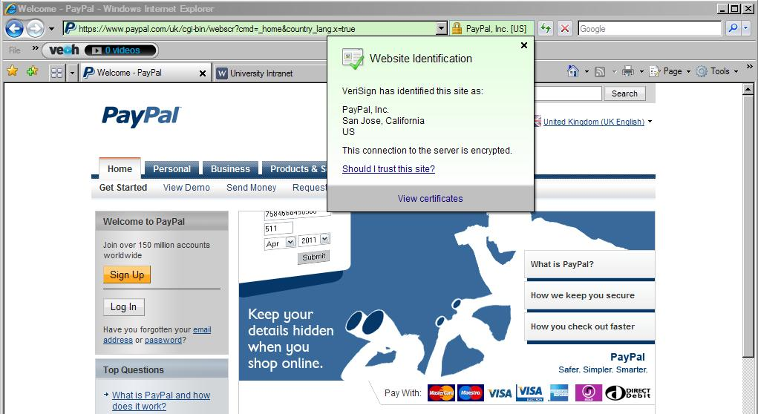

Slide 9
Communicating risk graphically
Graphical representations of risk magnitude help users a lot
Analogies, relevant representations and comparisons are needed
Security software frequently uses padlock images to display overall state
Encryption software often uses images of safes as an analogy for volumes
Problems
Displays can often be overly intrusive
A false alarm can prevent a knowing user from achieving a legitimate task

Slide 10
Numerical representations
Statistical information can be presented in a variety of ways
When risk is presented as a probability esp. a conditional probability it is considered more confusing than a simple numerical example
Example of e-commerce
0.1% of commercial websites infected with a virus
Anti-virus software of a user is 99.9% effective
Also 0.1% probability of false alarm
What is the probability that the website being visited by user is infected, given that a warning alarm was displayed?
P(i|w) = probability of infected site given that warning is shown
P(w|i) = probability of warning being shown given that site is infected
P(i) = probability of site being infected
P(w) = probability of warning being shown

Slide 11
Probabilities vs. figures
Bayes’ theorem allows calculation of correct probability:
In a local study conducted by the authors only 3 out of 30 participants responded correctly!
Alternative presentation of the problem using natural frequencies enabled 13 out of 30 participants to get the correct answer!
This simple example demonstrates how the way in which online risk is communicated influences peoples’ understanding of it

Slide 12
Work in progress
We have only briefly considered
Visual representations of risk
Numerical representations
Current work has involved
Bridging the gap between purely social research and computer science
Surveying the literature in cognitive science for techniques and tools that might influence human perceptions of online risk
Conducting a small-scale experiment with numerical representations in order to validate the research of Gigerenzer and Edwards in the context of online risks
Future work
To develop a proper, extensive model of online risk
To investigate different types of security policies and how they can be communicated most effectively

Slide 13
The Bigger picture
We expect that this work will lead to a large-scale interdisciplinary project, which will enable
Security experts to better understand the user’s perspective
Psychologists and cognitive scientists to better understand how users perceive threats and danger in the digital age
This work is likely to impact other security research
E.g. Project EnCoRe (“Ensuring Consent and Revocation”) is a large-scale UK project focused on developing privacy controls for systems and software

Slide 14
references
Gigerenzer, G., & Edwards, A. (2003). Simple tools for understanding risks: from innumeracy to insight. British Medical Journal, 327, 741-744.
Lipkus, I. M., & Hollands, J. G. (1999). The visual communication of risk. Journal of the National Cancer Institute Monographs, 25, 149-163.
Slovic, P. (1987). Perception of risk. Science, 236, 280-285.
Sparrow, J. A. (1989). Graphical displays in information systems: Some data properties influencing the effectiveness of alternative forms. Behaviour & Information Technology, 8(1), 43-56.

